Slide 1
SMARTPHONE INSTRUMENTATION FOR COLLAPSE DETECTION OF BUILDINGS
EVALUATION PRESENTATION
A MOBILE CROWD-SOURCING APPROACH TOWARDS EARTHQUAKE DETECTION AND EARLY WARNING SYSTEM

Slide 2
Problems tested
Accelerometer delay mode
Threshold
Battery consumption
Server stress test

Slide 3
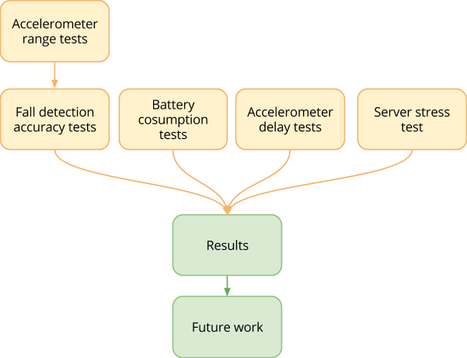
Evaluation Process

Slide 4
Set Up
Test types and objectives
Test procedure
Environment
Participants
Data collection

Slide 5
Test types
Accelerometer range tests
Accelerometer delay tests
Accurary test
Battery consumption tests
Server stress test

Slide 6
Test procedure
Users launched the plugin and continued their daily activities normally
Conduct accelerometer delay and threshold tests as the plugin ran in the background
Test subjects were able to answer a questionnaire
Accuracy was tested with different threshold-delay pairs
Heuristic evaluation in a free form question
Stress test script was made for server

Slide 7
Accelerometer range tests
Test a few phone drops were completed with threshold 0.8
Majority of those drops repeated values in the range of 0.2 to 0.6.

Slide 8
Accelerometer delay tests
Fatest mode: 6 days 7 hours
Game mode: 5 days 11hours
UI mode: 6 days
Normal mode: 10 days

Slide 9
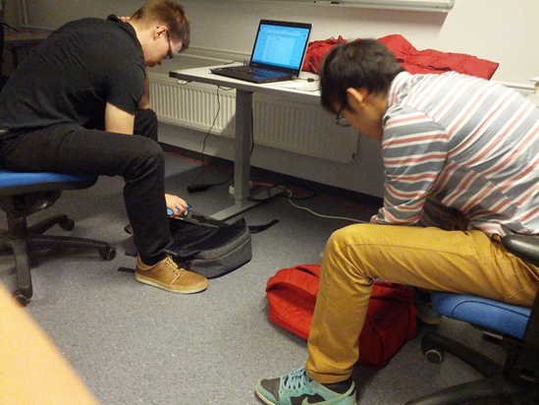
Accurary test
Phone Models
OnePlus One, Galaxy Nexus, Galaxy S4 mini
Way to test
Tested with three difference phones
Height,accelerometer delay and threshold are considered
In each case phones were dropped 40 times
Drop on a soft surface

Slide 10
Battery consumption tests
Run the plugin with all the different accelerometer modes: Fastest, Game, UI and Normal
Completed with same device
Each of the modes were used for 3 hours
Monitored the percentage of the battery

Slide 11
Environment
User environment (smart phones)
Wireless internet and GPS
Installed Google Maps and Aware system
Android phone
Developers environment
Server software
Android development tools
Testing environment
External libraries

Slide 12
Participants
7 users
1 female and 6 males
Age from 22 to 31
Live near Oulu university
4/7 users are used to ride bicycle
2/7 users often go to gym
Smartphone users

Slide 13
Data collection
Accelerometer value, location, phone id and timestamp are collected by passive testing
Questionnaire based on user experience by mail and phone calls

Slide 14
Questionnaire
What kind of phone do you have (model)
What version of Android do you have? Instructions: http://www.wikihow.com/Check-What-Android-Version-You-Have
What kind of activity triggers the fall pop up message the most (bicycling, running, dropped the phone, inside backpack, place it on a table…)
How often do you drop your mobile?
What do you think of the battery consumption, did you notice any difference with different accelerometer delays (Fastest, normal, game, UI) which would you prefer?
Do you think the accelerometer delay affected the amount of detected falls?
Do you think the used threshold affected the amount of detected falls?
How often you turn on the app
Have you ever turned off the app that was already running, if yes of what specific reason?
If you live/lived in high earthquake risk area would you voluntarily install this app?
How could the app be improved to make it more attractive?
Did you have any problems during the installation?
Did any crashes happen during the app usage and for what reason?
Any other comments?

Slide 15
Data and Results
Questionnaire data
Pop up messages triggered by dropping phone on bed, on table, on floor, dismounting from bicycle, riding bicycle
Accidentally dropping phone from longer heights is pretty rare
5/7 users dislike the fastest accelerometer delay mode
6/7 launched the plugin at least once a week
All people were glad to install the app
Some people meet problem when installing the app because their phone was old or Aware did not recognize the plugin

Slide 16
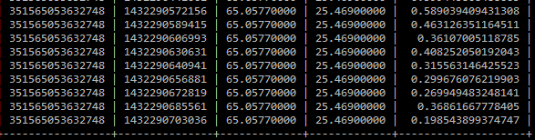
Data and Results
Range of fall event accelerometer data

Slide 17
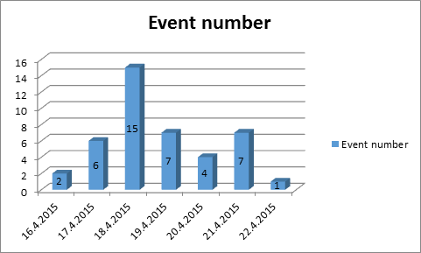
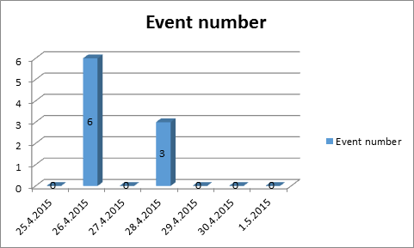
Data and Results
Amount of fall events per day
Fastest mode
Game mode

Slide 18
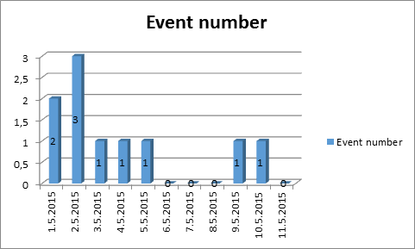
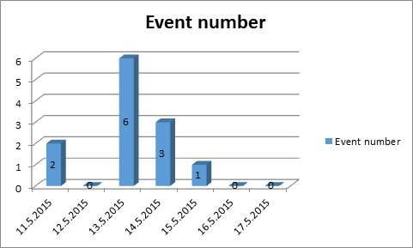
Data and Results
Amount of fall events per day
Normal mode
UI mode

Slide 19
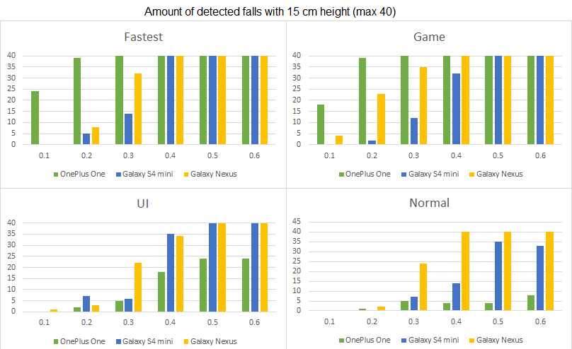
Data and Results
Accuracy data(15cm)

Slide 20
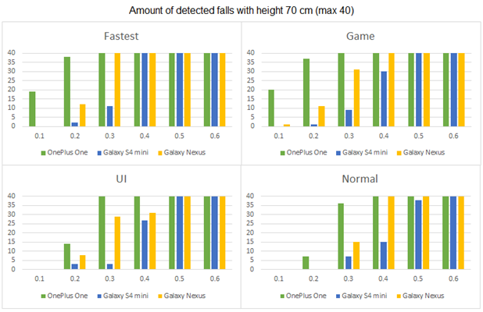
Data and Results
Accuracy data(70cm)

Slide 21
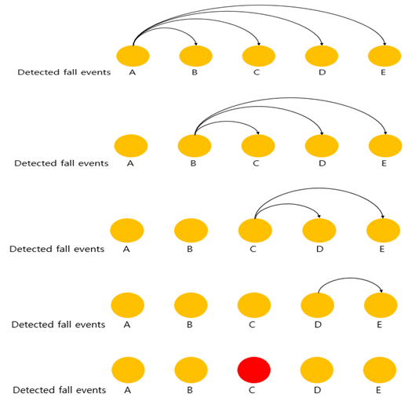
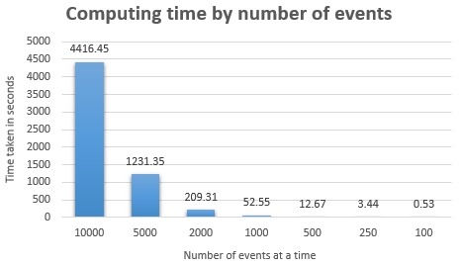
Data and Results
Stress testing on server

Slide 22
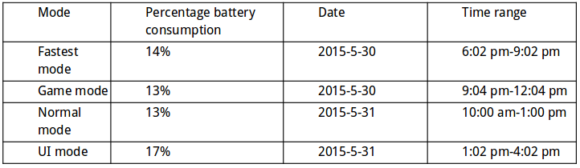
Data and Results
Battery consumption

Slide 23
Analysis
Overview
Threshold tests
In theory, the accelerometer should be 0 during free fall
In real life,the range of accelerometer varies from 0.2 to 0.6
More falls occur with the higher threshold

Slide 24
Analysis
Overview
Accuracy results
The higher height falls was easier to detect with lower delays
Difficult to predict the height or trajectory phone will experience during an actual building collapse
For thresholds higher than 0.3, the fastest and game modes performed the best in both lower and higher drop heights

Slide 25
Analysis
Overview
Server computing time results
Resolving computing time issue is critial
A new algorithm required
Generating multiple threads assigned one for each set of data to be calculated
While data is put into calculation applying pre-defined assumption could reduce computing time remarkablaly by removing isolated data

Slide 26
Analysis
Scalability
Extension of the system onto smartwatch platform
Webpage for other stakeholders such as researcher or emergency organization
Multiple server centers over targeted area or a country to minimize data travel time and also stable, high speed and reliable network infrastructure

Slide 27
Analysis
Overview
Battery consumption results
Some feedback was given about high battery consumption with faster accelerometer modes from user tests
Test results did not match the expected results
The slower accelerometer delays seems to consume more battery than the faster ones from the results.
Small data sample for an analysis

Slide 28
Analysis
Fault tolenrance
Major wrong cause of falls such as while placing the phone quickly on a surface or while riding bicycles need to be fixed by adding exceptions or conditions and so
If plugin is crashed, the system should notify user to restart plugin
Back up server is ready to take up the task

Slide 29
Analysis
Security
Security level is basic
Both server and client required to have two types of keys which are private and public
Need to improve security level in the future (e.g. tolerant in DDoS attack)

Slide 30
Future work ideas
Set the modes and thresholds to match for the best performance
Find the times when users are more active
Use fastest mode when phone is charging
Implement new features
Web service, news reporting...
Support more devices

Slide 31
Thank you!

